Slide 1
Creating Access for Immigrant Families to Ensure Best Outcomes
Tere Ramos
Massachusetts Law reform institute
Notes:
This will be an interactive discussion, try to keep people from falling asleep after lunch!
My name is Tere Ramos, I am the language access attorney at the MA Law Reform Institute
We are the poverty law center for MA.
I am also the mother of a 15 yo girl with autism. So as the commercial says, “I’m not only the President I am also a client.”
I work exclusively with families who live in poverty, who are immigrants, who do not speak English well. Most of them are a combination for the three.
My hope today is to have a conversation with you in how to improve the work we do in reaching those communities.
I know many of you are strong advocates for our kids, and you may know some of this information, but I hope it will help us converse and improve.

Slide 2
A Country of Immigrants
http://www.nytimes.com/interactive/2009/03/10/us/20090310-immigration-explorer.html?hp
Notes:
CLICK ON THE MAP FIRST.
How many of you were raised in a household where during the holidays, instead of going to grandma’s you went to abuela’s house, or Oma’s house, or Giagia’s house, or Nai Nai’s house, or a vovo?
As this map shows, immigration has always existed, the difference is where immigrants come from.

Slide 3
Immigrants in Massachusetts
9.5%
12.2%
15.6%
Notes:
The number of immigrants in MA has increased in the last 25 years.
While the US born population has remained pretty stable, the foreign born population has gone from 9.5% to 15.6%

Slide 4
An Integral Part of the Economy
$1.7b to IRS
18.7%
$960m in MA state/local taxes in 2013
Workforce in 2013
State would lose $12b in economic activity by removing unauthorized immigrants.
Notes:
Immigrants comprised 18.7% of the MA workforce in 2013.
In terms of undocumented immigrants, they paid $184 million in taxes in 2017.

Slide 5
Three Main Areas of Focus
Culture
Language
Immigration Status
Notes:
Today we will talk about three areas that present common “walls” or roadblocks to accessing services and to adjusting to life in the United States.
When it comes to language and immigration status I will explain a bit on the legal requirements that agencies receiving state and federal funds have to ensure everyone is included, regardless of their national origin. We will also discuss some cases to highlight why these policies are so important.
When it comes to culture, I will highlight some things for you to think about as you go about your day, helping these families. The purpose is again, to broaden our perspectives and make our services more culturally competent.

Slide 6
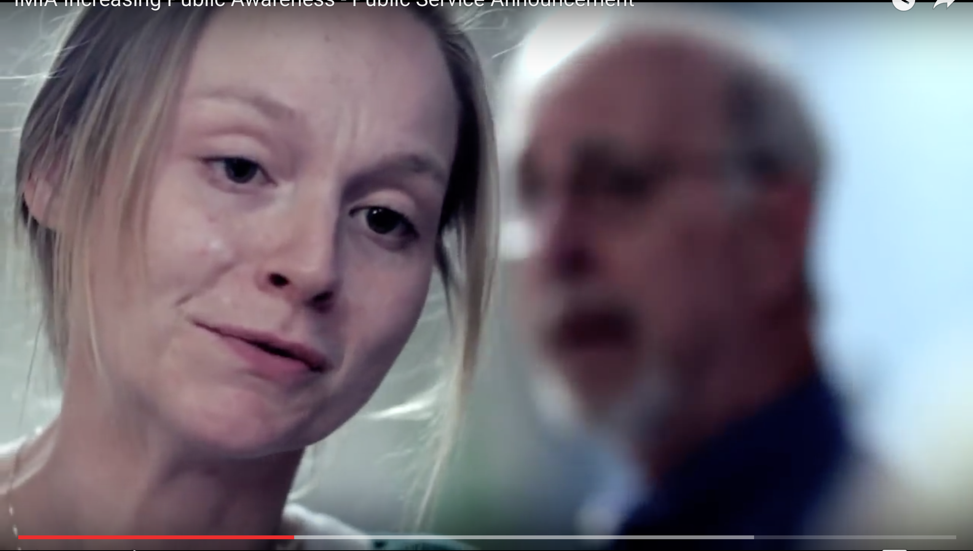
Language Access
https://youtu.be/twINuqacDdY
Notes:
AFTER VIDEO ASK: Why do we think language access matters?

Slide 7
Why Do Language Rights Matter?
U.S. becoming a “majority minority” country.
In MA, 22% of the population speaks a language other than English at home.
Provides access to decision making.
Without them a person may unknowingly waive rights to services.
It is discrimination, same law as if person is not provided services due to color of skin or race.
Notes:
In contrast: 49% of population in NYC speak a language other than English at home.
I would like to tell you a cautionary tale of a family who lost basically everything due to lack of language access.
Figure my client, a Mom. A widower with three girls. The oldest is 16, the youngest is 9, and has severe special needs.
Mom struggles to put food on the table, she works several shifts- while girls are in school and sometimes in the evening. Her daughter has severe behavior problems, so they keep calling her to pick her up from school. She calls to work she can’t go to the factory, so she is fired. Thankfully, her daughters get Masshealth, and her youngest gets SSI.
A couple of months later, Social Security sends her a letter asking for her income information ,except it is in English, it sits on her table, she can’t read it.
Next thing she knows, Social Security doesn’t deposit her daughter’s money. She goes to the SS office, where a worker tells her from behind a window that her daughter’s benefits are stopped because they think she has made too much money. They won’t give her any more information, she tells her she has to read the notice. She tries going to her family support worker, who reads her the notice. Mom tries to go again to Social Security but they tell her they do not have a Spanish speaking worker that day, so she can’t ask questions on why they think she makes too much money, to try to fix it.
Because she didn’t get the money, she has not been able to pay rent. The landlord takes her to court to evict her. In the courthouse, thankfully they give her an interpreter, and while the judge is sympathetic, she owes the landlord money and she gets evicted.
Now she’s in a homeless shelter, with three girls. The shelter is 40+ miles away from her daughter’s special education school, that she fought for years to get her into. Her oldest daughter is starting to have problems in her high school, which the guidance counselor thinks are a result of the stress and trauma of the situation. Mom feels desperate and depressed.

Slide 8
Who is an LEP person?
“Individual with a limited ability to read, write, speak, and understand English.”
Person “does not have to be limited in all “speaking, reading, writing and comprehending.”
Can be the family member of an English speaker who is involved in the care of that person.

Slide 9
It’s Not Only Wrong, It’s Illegal
Title VI of the Civil Rights Act of 1964 prohibits discrimination based on race, color, or national origin in programs or activities that receive federal financial assistance.
Language is a proxy for national origin.
Extends to all recipient and sub-recipient entities.
Notes:
Why Should we care?

Slide 10
What are the Language Rights?
LEP Persons have the same right as anyone else to use public programs in their language.
In all:
schools,
courts,
public housing,
public programs like EI
and Head Start
In most:
hospitals,
doctors’ offices
Staff of public programs must:
Talk in the person’s language
Help them as quickly as they can
Respect the client’s culture
This is a right, not a gift!
Notes:
Interpretation involves the oral communication from one language (the source language) into another (the target language).
Translation: rendering of written text from the source language into the target language.
Vital Document: A document that contains information that is critical for meaningful access to a program by LEP persons.

Slide 11
A Qualified Interpreter
https://youtu.be/ovwjLIfYuMw?t=1m4s
Notes:
Any one remember the story about the Sign Language Interpreter at Mandela’s funeral?
STOP VIDEO AT 2:47
GO DIRECTLY TO NEXT SLIDE TO EXPLAIN WHO IS AN APPROPRIATE INTERPETER

Slide 12
Who is an appropriate interpreter?
Appropriate:
Professional
Trained in subject
Qualified
Impartial
NOT Appropriate:
Minor children
Doesn’t know subject or terms
Unqualified to translate
Partial
Notes:
An interpreter SHOULD:
Treat you with respect
Make sure they understand what you say
Make sure you understand what they say
Interpret everything you say and the program says
An interpreter CANNOT:
Change your words
Leave out information
Talk about you
Take sides
Tell you what you should do

Slide 13
What are Vital Documents?
Depending on the frequency of the language, important written information that must be translated!
These include:
Applications to participate
Complaint and intake forms
Notices of rights or program administration
Written notices of rights
Appeal letters
Assessments used to determine eligibility or services
School documents
Standard forms that are considered “vital” to a program
Content on website
It if is a “vital” notice, it usually must be provided in a native language. If the person self-identifies as LEP, offer it!
Notes:
Vital documents need to be translated depending on the frequency of the language and the program you are in.
For example, education laws provide more expansive provisions regarding language access than does Title VI. In education, you have to translate all of the IEP process materials– evaluations, forms, IEPs, anything that allows the parent to provide “informed consent as part of the IEP Team.” This is regardless of the frequency of the language.
In terms of early intervention, this requirement is not as expansive. Under federal law (so for all programs that in some way stem from federal funds) there is a four part test that all providers should consider:
Number or proportion of LEP persons
Frequency of Contact
Nature and Importance
Resources Available
As a general rule they have a “safe harbor” (meaning if they were to investigate) and found that groups that meet a threshold of 5% of the pop. Of 1,000 people, whomever is less, you have translated documents.
For MA state funded entities (who do not receive any federal funds from ANY source) the requirement is 5% of population.
So if someone needs a document to be translated and they speak Kaba, which is a very uncommon language in MA, the person would not need documents translated, they can just have someone interpret them for them.
QUESTION: CAN I JUST GOOGLE TRANSLATE THEM FOR MY PROGRAM??

Slide 14
Google Doc is Not Appropriate. Ever.
https://youtu.be/4GC83w0z0ec
Notes:
I get a lot of calls whether someone can use google docs to translate documents. The answer is no. It is a useful tool if you speak both languages and want to increase your speed by attempting a first pass, and then reviewing and correcting, but in general it is pretty bad.
Stop at 1:20

Slide 15
What Does This All Mean?
An Individual with a limited ability to read, write, speak, and understand English has the right to:
Use public programs and communicate in the preferred language.
Set a language preference to receive vital written materials.
Right to an interpreter that is free, qualified, trained in subject, impartial, and ensures person understands what everyone says.
Even if the person has some command or knowledge of the language, if they understand their own language better, they can ask for services!

Slide 16
Immigration

Slide 17
Immigrant Children Must be Educated
Plyer v. Doe- A State may not deny access to a basic public education to any child residing in the state, whether present in the U.S. legally or otherwise.
“By denying these children a basic education, we deny them the ability to live within the structure of our civic institutions…”

Slide 18
But the Child Must be a Resident
Martinez v. Bynum- As long as the child is not living in the district for the sole purpose of attending school, s/he satisfies the statutory test.
“A bona fide residence requirement, appropriately defined and uniformly applied, furthers the substantial state interest in assuring that services provided for the State's residents are enjoyed only by residents.”
Notes:
New York by Schneiderman v. Utica School District- 2015; and Tuyizere v. Utica School District- 2015
Both cases allege the district has systemically excluded refugee LEP students over 16 years old from Proctor High School, the only high school in Utica.
The district diverted them to alternative “Newcomer Program” for newly arrived immigrants that provided ESL instruction but no content area instruction, such as math, science or history. Since 2014 the district provided GED classes to students to test well on an English proficiency exam. All others had to remain in ESL-only classes.

Slide 19
José and His Family
https://youtu.be/r4imLLVGTrA https://youtu.be/VTTeW0Zrp2s
Notes:
In this excerpt from the Independent Lens documentary East of Salinas, Jose's stepfather Jaime prepares to travel to Yuma, Arizona, a 12-hour drive from Salinas, to find seasonal work in the fields. He must follow the farm jobs, even if it means separating leaving his family for a place many migrants fear: the U.S.-Mexico border. It shows the kind of decisions these families must make so their kids can have a more consistent life, and go to one school rather than more constantly.
Third-grader Jose, who is an expert at math, finishes his homework before he can do anything else for the evening. His grades are important to him because he desperately wants to make the fourth grade so he can go on a promised field trip to the beach, where he's never been.

Slide 20
Enrollment Rights of Immigrants
A School district may require some form of residency within the district. Phone and water bills, lease agreement.
Residency requirements must be applied uniformly.
District cannot ask for parent’s driver’s license to establish residency if doing so would bar a student whose parents are undocumented from enrolling.
Cannot ask for citizenship or immigration status of parents or child.

Slide 21
Enrollment Requirements and Rights
Cannot bar enrollment because student lacks a birth certificate or a social security number (ss#).
If district asks for ss#, it must inform that providing is voluntary, and for what purpose it will be used.
Under McKinney Vento, if the student is homeless, the district must immediately enroll the child, even if the parent/guardian can’t produce records normally required for enrollment. 42 U.S.C. § 11432(g)(3)(C)(1)

Slide 22
ICE Guidance on Sensitive Locations
ICE guidance published October 24, 2011
Policy is to ensure enforcement actions do not occur at “sensitive locations” such as schools, hospitals, churches, unless:
Exigent circumstances exist
Other law enforcement actions lead to location
Prior approval is obtained
Unless:
Enforcement action involves national security or terrorism
Imminent risk of death, violence, physical harm
Involves pursuit of dangerous felon, terrorist or destruction of evidence material.
Notes:
So that is a snapshot on life as an immigrant and things you can advocate for to ensure all these families have access to an education for their children.
For the last part of my presentation, We can talk a bit on how to help not only in advocating on behalf of these families, but how to help them adjust.

Slide 23
Helping Immigrant Families Adjust
https://youtu.be/A5gkQ4_aAeY?t=2s
Notes:
ASK: So what are ways you think you can help immigrants adjust in your programs and work?
Show video:
THEN RESPOND:
This video shows you three examples:
Hire staff that mirrors the community you serve
Provide language access so they can communicate with you
Find people who knows their culture- it doesn’t have to be just staff that are from the culture, but sometimes folks who have lived in the country as well.
Provide opportunities for those in the program to get to know each other and respect each other (if appropriate, for example, in a preschool program, parents may not intermingle, so immigrant families lose out on opportunities to volunteer or become involved).
Do not make assumptions on someone’s background. The mentors on the videos started in a refugee camp in Africa! (There may be someone who was very educated in their home country and now can’t find a job due to language or status).

Slide 24
Many Kinds of Privilege
Sexual Orientation | Employment | Families relation to education
Class | Physical Ability | Housing
Region | Handedness | Neighborhoods
Religion | Languages | Country of Origin
Gender | Nation of Origin | Income
Ethnicity | Race | Sex
Notes:
STORY:
Client who came from Vietnam, family is first generation. Mother uses traditional Vietnamese medicine.
Son got sick, she cupped him.
Nurse saw the cupping. Instead of asking questions called DCF
Call caused great hurt and really ruined a relationship with the school.

Slide 25
Match nonverbal and verbal messages
To create a positive environment for communication, your nonverbal message must closely match your verbal message.
Recognize your own expectations about nonverbal communication, and then find ways to learn about those of individuals and other cultures. Understand your prejudices and privileges.
Nonverbal messages have a powerful impact on what’s communicated.

Slide 26
Creating Bridges: Consider
Learn about the community you are representing: Accurate knowledge about the diversity of clients, their needs and preferences for receiving information, use them to guide your communication practices.
Providing materials in appropriate languages and offer professional interpreting services; don’t make them beg for them.
Show the community that you value them. Diversity in staff at all levels shows that you see them as part of your internal circle.

Slide 27
For Question or To Contact Us
Tere Ramos
MA Law Reform Institute
40 Court St.
Suite 800
Boston, MA 02108
Tel. (617) 357-0700 x 350
E-mail: tramos@mlri.org

