Slide 1

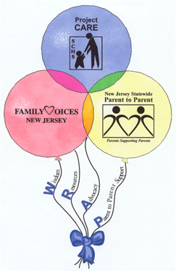

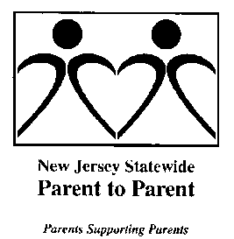



Leveraging Partnerships for Collective Impact in New Jersey
Deepa Srinivasavaradan - CDC’s Act Early Ambassador to NJ
Notes:
Introduction – LTSAE NJ focus and SPAN vision & mission
LTSAE NJ Focus - Leveraging partnerships to ensure that all efforts related to early developmental monitoring and screening are working together to compliment each other, maximize impact and reduce duplication. This allows opportunities for creation of policies and protocols to address gaps and ensure consistency in access to effective screening, and development and dissemination of NJ-specific, family-friendly, culturally competent tools and resources to meet identified needs.
SPAN is a "one stop" for New Jersey families and is the Parent Training & Information Center; Family to Family Health Information Center; Family Voices State Affiliate Organization; Parent to Parent USA affiliate; and a chapter of the Federation of Families for Children's Mental Health. Nationally SPAN is a partner with Family Voices on the National Center for Family Professional Partnerships, funded by the Maternal and Child Health Bureau, and houses the National Center for Parent Information and Resources and the National RAISE Transition Parent TA Center, funded by the US Department of Education.

Slide 2
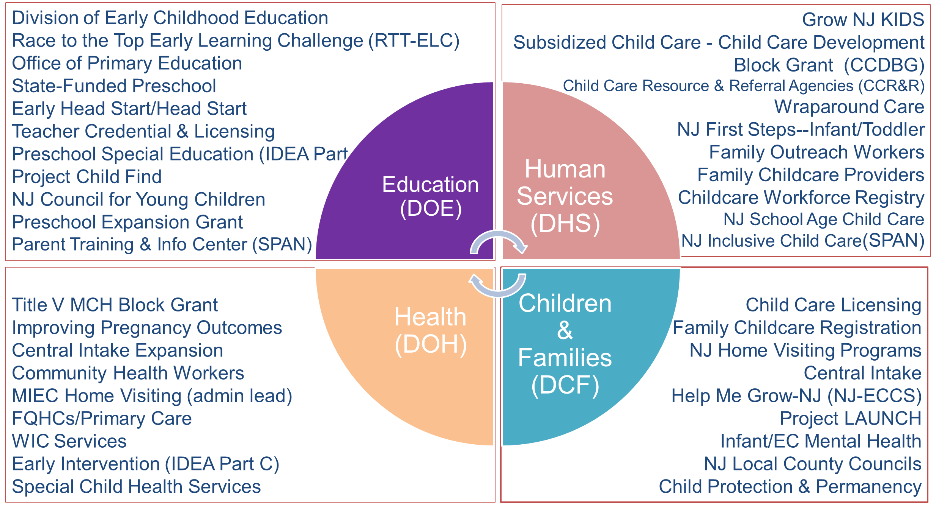

Early Childhood Services Across Departments
Notes:
In New Jersey, we have various early childhood programs and services across state departments, the DOE, DHS, DCF and DOH.
Learn the Signs. Act Early (LTSAE) information and resources are shared by all SPAN projects with the families and professionals with whom they work. For example: The NJ Inclusive Child Care Project (NJICCP), funded by NJDHS, disseminates LTSAE materials as part of their screening trainings and TA (including how to talk to parents) for family child care providers in all 21 counties.
In addition, SPAN encourages our multiple state and local partners, from state agencies and statewide organizations, including those focused on child care, healthcare, mental health, immigrant issues, etc.; to county Child Care Resource and Referral Agencies, County Councils for Young Children, Special Child Health Services Case Management Units, FQHCs, Family Support Organizations, etc.; to local community-based and child and family-serving organizations, to disseminate the materials. SPAN is partner in facilitating one of the county Councils for Young Children, and has a contract with our state Department of Children and Families to train and support the parents of young children and other members of all the county Councils for Young Children on Serving on Groups (www.servingongroups.org; http://www.spanadvocacy.org/content/serving-groups-webinar-series-and-resources) as well as the staff of the organizations that house the councils, so we are able to share these resources with families and professionals involved in those county councils. We also are funded through the Child Care Development Block Grant and the Race to the Top Early Learning Challenge for our NJ Inclusive Child Care Project which works to support the early identification and screening of young children in child care and Head Start and the inclusion of young children with special needs in typical early childhood settings, which provides another forum in which to disseminate materials.

Slide 3
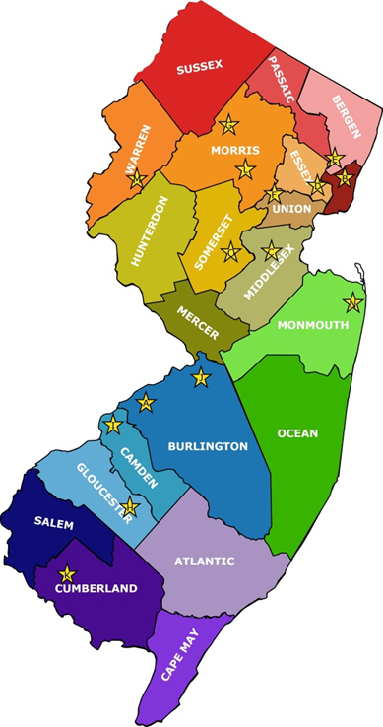
NJ Act Early State Team
State Agencies
  NJ Department of Health Division of Family Health Services
    Special Child Health & Early Intervention Services
    Improving Pregnancy Outcomes/Central Intake
  NJ Department of Children & Families
    Help Me Grow; Project LAUNCH; Home Visiting; Children’s System of Care
  NJ Department of Human Services
    Division of Development Disabilities, Office on Autism
Notes:
Working with the Act Early State Team on the Act Early State Implementation Grants funded by AMCHP, the LTSAE Ambassador has disseminated Act Early materials and provided information on “Red flags in child development” to Federally Qualified Health Centers and Head Start/Early Head Start Programs through parent-led screening trainings. Through this effort, county-specific and statewide flowcharts were developed to serve as quick reference guides to help families and professionals get started with connecting with several important types of services and supports when developmental concerns are identified in young children. This work was coordinated by NJ’s UCEDD & (now also NJLEND), the Boggs Center, and SPAN, but was also supported by the Early and Continuous Screening workgroup of the Community of Care Consortium.

Slide 4
NJ Act Early State Team
Other Organizations
Boggs Center on Developmental Disabilities (UCEDD, LEND)
NJ Council on Developmental Disabilities
Statewide Parent Advocacy Network (PTI, F2F, FFCMH, P2P, etc.)
Governor’s Council for Medical Research & Treatment of Autism
Center of Excellence on Autism at Montclair State University
American Academy of Pediatrics-NJ Chapter
Disability Groups (Autism NJ, POAC, Autism Family of Services, the Arc)
Notes:
Working with the Act Early State Team on the Act Early State Implementation Grants funded by AMCHP, the LTSAE Ambassador has disseminated Act Early materials and provided information on “Red flags in child development” to Federally Qualified Health Centers and Head Start/Early Head Start Programs through parent-led screening trainings. Through this effort, county-specific and statewide flowcharts were developed to serve as quick reference guides to help families and professionals get started with connecting with several important types of services and supports when developmental concerns are identified in young children. This work was coordinated by NJ’s UCEDD & (now also NJLEND), the Boggs Center, and SPAN, but was also supported by the Early and Continuous Screening workgroup of the Community of Care Consortium.

Slide 5
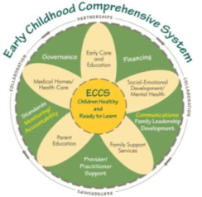



Overview of NJ’s Early Childhood System of Care
  Building an Integrated System of Care for Early Childhood (EC )-Pregnancy to Age 8
  Central Intake (CI) Hubs – all 21 counties (DOH, DCF, DOE)
    ECCS/HMG, Improving Pregnancy Outcomes, NJ Project Launch
  Prenatal Screening & Risk Assessment (PRA)
  Linkages to Pediatric Primary Care / Medical Home
  Linkages to programs providing Infant and Child Developmental Screening
Notes:
New Jersey has two early childhood systems integration initiatives – ECCS/Help Me Grow and New Jersey Project LAUNCH, which aligns with our work through Race to the Top. ECCS/HMG has a statewide approach and NJ Project LAUNCH has a local focus on Essex County.
The Central Intake hubs, funded by Departments of Health, Children and families, and Education, are in all 21 counties. These hubs act as county based Help Me Grow hubs, supporting local level linkages for children and families to early childhood programs as well as health and social services. These services include but are not limited to:
Prenatal Screening & Risk Assessment (PRA)
Linkages to Pediatric Primary Care / Medical Home
Programs providing Infant and Child Developmental Screening
Home Visiting, childcare and other early childhood services
Health education and outreach, to hard to reach communities, through Community Health Workers which are funded by the Department of Health in 13 counties
Grow NJ Kids, a new quality rating and improvement system designed to create a universal standard of quality for all early care and education programs. SPAN’s NJ Inclusive Child Care Project is a collaborating partner and has developed and delivered training for family child care providers on early identification and screening as well as training and on site TA to child care programs.
CHW’s including the CHWs in SPAN’s Improving Pregnancy Outcomes project disseminate LTSAE materials.

Slide 6
Overview of NJ’s Early Childhood System of Care
  Building an Integrated System of Care for Early Childhood (EC )-Pregnancy to Age 8
  Linkages to Home Visiting (HF’s, NFP’s and PAT’s) – 3 models in all 21 counties
  Linkages to Quality Child Care – Grow NJ Kids (QRIS) childcare and other EC services
  Health education and outreach to hard to reach communities – Community Health Workers (DOH) – 13 counties
Notes:
New Jersey has two early childhood systems integration initiatives – ECCS/Help Me Grow and New Jersey Project LAUNCH, which aligns with our work through Race to the Top. ECCS/HMG has a statewide approach and NJ Project LAUNCH has a local focus on Essex County.
The Central Intake hubs, funded by Departments of Health, Children and families, and Education, are in all 21 counties. These hubs act as county based Help Me Grow hubs, supporting local level linkages for children and families to early childhood programs as well as health and social services. These services include but are not limited to:
Prenatal Screening & Risk Assessment (PRA)
Linkages to Pediatric Primary Care / Medical Home
Programs providing Infant and Child Developmental Screening
Home Visiting, childcare and other early childhood services
Health education and outreach, to hard to reach communities, through Community Health Workers which are funded by the Department of Health in 13 counties
Grow NJ Kids, a new quality rating and improvement system designed to create a universal standard of quality for all early care and education programs. SPAN’s NJ Inclusive Child Care Project is a collaborating partner and has developed and delivered training for family child care providers on early identification and screening as well as training and on site TA to child care programs.
CHW’s including the CHWs in SPAN’s Improving Pregnancy Outcomes project disseminate LTSAE materials.

Slide 7
Aligning LTSAE with Early Childhood Systems
  Community of Care Consortium (COCC) Meetings
    Early & Continuous Screening Workgroup co-chaired by LTSAE Ambassador & HMG/ECCS Coordinator
  Infant Child Health Committee (ICHC) Meetings
    LTSAE Ambassador provides updates at each meeting
    LTSAE Ambassador & other SPAN staff participate on workgroups
  Information Sharing Workgroup of ICHC
    LTSAE Ambassador helps plan & disseminate early childhood health-related information including LTSAE materials
Notes:
Stakeholders participating in the statewide meetings include representatives from NJ Department of Health/Title V, NJ Department of Human Services/Office on Autism, NJ AAP, NJ Primary Care Association/FQHCs, NJ Early Intervention Services, NJ Head Start Association, other organizations serving children and families across the state as well as diverse parent leaders. The workgroups of the COCC are based on the core outcomes for children and youth with special health care needs – Early and Continuous Screening, Medical Home, Transition and Health Care Financing. Each workgroup of the COCC meeting is co chaired by a parent leader and a professional or state agency representative.
The Early & Continuous Screening Workgroup is co-chaired by the LTSAE Ambassador along with ECCS/HMG Coordinator as it is aligned with the Infant Child Health Committee workgroup. We have the opportunity to come together with other state partners who are involved with Early Childhood systems work.
The Infant Child Health Committee is our cross sector early childhood stakeholder group; Help Me Grow/ Early Childhood Comprehensive Systems initiative, NJ Project LAUNCH, and other early childhood partners statewide have aligned with this committee to operate as their state level stakeholder group. The priorities of this committee include family/child health, infant/child mental health and children with special needs. The work of this committee is to address barriers and gaps, strengthen linkages to resources and supports around these priority areas, which impact state and local level issues.
LTSAE Ambassador provides updates to enable ongoing collaboration with stakeholders present at the meeting. LTSAE Ambassador and other SPAN staff participate in the workgroups of this committee to provide input on the Physicians Workgroup and the protocols of the HV programs so they all have access to SPAN resources for families as well as the Act Early materials customized with local resources and information.
LTSAE Ambassador participates in the planning and dissemination of health related information topics that impact the early childhood population to local/state stakeholders and parents, inclusive of LTSAE materials (brochures, booklets, etc.)

Slide 8
Help Me Grow & Early Childhood Comprehensive Systems (ECCS) Impact
Notes:
Early Childhood Comprehensive Systems/Help Me Grow is an early childhood systems integration initiative, working closely with state and local early childhood stakeholders ensuring a unified and coordinated approach to addressing the needs of pregnant women, infants and young children and their parents and families.
ECCS/HMG works with public and private partners to facilitate linkages across programs, disciplines and sectors – prenatal/parent and child health, behavioral health, home visiting, Head Start, family support, social services, child care, preschool and elementary education, early intervention, special education, and child welfare.
ECCS/HMG has a focus to expand the reach of early childhood developmental screening for children birth to age five. The focus is on increasing linkages to improve physical, social and emotional development during infancy and early childhood to support early learning and development, which in turn supports school readiness. ECCS goal is to eliminate the disparities to accessing early childhood services through systems integration, collective impact and improving the quality and availability of services at the state and local level.

Slide 9
LTSAE Collaboration with HMG/ECCS
  NJ ECCS Impact Team
    State-level Improvement Team
    LTSAE Ambassador is the parent lead for the state-level improvement team
    5 place based teams from 5 counties (Central Intakes, CCYCs & Parents)
Notes:
State ECCS Impact team includes 5 place based teams from 5 counties working on improving the early childhood system for children around developmental health promotion and early screening.
The 5 place based teams also have parents leads working with each of their teams. They will be using LTSAE materials including customized Child Development Passports that have been printed in collaboration with Help Me Grow NJ and will be "Mini Champions" for LTSAE within their communities.

Slide 10
LTSAE Collaboration with HMG/ECCS
  ECCS Learning Session & Help Me Grow Forum
    LTSAE Ambassador attended as invited/funded member of state team
  North East Regional Act Early Summit
    LTSAE Ambassadors in the North East region planned & hosted NE Regional Act Early Summit
    NJ team included stakeholders across EC Systems
Notes:
LTSAE Ambassador was invited by the state HMG team to attend the forum with them. Funds to support Ambassador’s attendance every year was also provided by the state HMG team.
NJ’s LTSAE Ambassador in collaboration with LTSAE Ambassadors from other North East States (CT, RI, MA, ME, NH, VT) hosted the North East Regional Act Early Summit where each state was able to bring a team of up to 14 team members to participate. It was a wonderful opportunity for state teams to learn from each other and come up with strategic priorities to work within each of our states and to revitalize the Act Early Teams in NJ and other participating states. The NJ team included representatives from the state HMG team.
Participation in these initiatives has enabled promotion of LTSAE program and resources and has helped foster collaborative partnerships to build on existing and ongoing efforts to improve early screening initiatives and connection to early intervention services.

Slide 11
NJ LTSAE/HMG/ECCS Accomplishments
  HMG/LTSAE Child Developmental Passports – include Developmental Screening and Well-Visit Trackers so parents can keep track of the developmental screenings completed, results of those screenings, immunizations, height, weight etc. in one booklet to take with them for their child’s well-visit appointments
  Child Developmental Passports featured in Act Early Network News and Exceptional Parent Magazine

Slide 12
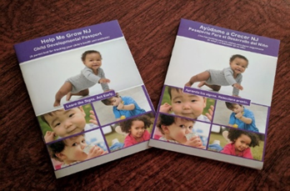
NJ’s Child Developmental Passports
Notes:
A tool that parents can use along with the Center for Disease Control’s (CDC’s) Milestones Moments booklet to track their child’s health, wellness, and development. It includes:
Definitions of Developmental Monitoring and Screening
Well-Child Visit Tracker to track child’s height, weight, immunizations, etc., and particularly head circumference which is critical information, given the current Zika crisis
Developmental Tracker to track child’s developmental and/or autism screening information including results and referrals for follow-up
Notes Section to help keep track of child’s growth and development
Contact information for NJ Early Intervention, Project Child Find, Statewide Parent Advocacy Network (SPAN) – NJ’s “one-stop” for families with children, and Help Me Grow NJ’s Central Phone Line
The Passports are available in:
ENGLISH: http://www.spanadvocacy.org/sites/default/files/files/Child%20Development%20%26%20Health%20Passport-English.pdf
SPANISH: http://www.spanadvocacy.org/sites/default/files/files/Spanish%20Passport%20%282%29.pdf

Slide 13
NJ LTSAE/HMG/ECCS Accomplishments
  LTSAE –Screening Resources Webinar – flash drives provided with resources to everyone who completed the webinars. Resources included: Medical home binder, LTSAE materials, etc.
  Customized and printed Milestones Brochures with NJ-specific resources in both English and Spanish - Includes Help Me Grow/NJ 2-1-1 phone line
  Customized Milestones Brochures featured in NJ AAP Pediatric magazine (available online and mailed to chapter members)
Notes:
We recently recorded a webinar about important resources for providers, case managers and others to connect families to when developmental concerns are identified for their children. The impetus for this webinar came from the Act Early Regional summit we attended in May, when it became clear that many of the partners, who are busy and not able to be as involved in all the initiatives as they might like, were unaware of the different resource compendiums that have been developed through our State Systems Grants and the work of NJ’s Community of Care Consortium. The plan is to upload the resources mentioned in the webinar on to flash drives (to be provided by DCF) and be made available to partners who complete the evaluation after listening to the webinar.
This work also builds and extends relationship built through the integrated systems grant projects related to medical home and developmental screening and, the help me grow, ECCS, project launch, and race to the top initiatives.

Slide 17
Current LTSAE Goals & Workplan
  Increase the adoption and use of LTSAE materials by NJ home visitors and WIC providers to engage parents served by these programs in developmental monitoring and encourage early screening, diagnosis, and connection to services
    Reach out to NJ’s Home Visiting and WIC programs
    Present LTSAE program and materials at the statewide meetings of both programs
    Develop a plan to integrate LTSAE materials and information into professional development provided to early childhood programs, including home visitors
Notes:
Workshops and/or trainings on developmental milestones monitoring, importance of early screening and tips for talking to parents will be made available for NJ’s Home Visiting and WIC program staff via in-person training, web-based workshops, and archived webinars/ workshops.

Slide 18
Current LTSAE Goals & Workplan
  Increase the adoption and use of LTSAE materials among programs serving diverse families, including early care and education, FQHCs, and other community-based, faith-based family-serving organizations throughout NJ
    Reach out to diverse communities and organizations (Ongoing - with the help of cultural brokers)
Notes:
Outreach to faith based organizations such as churches, temples, and mosques, libraries, museums, grocery stores, salons, food pantries etc.

Slide 19
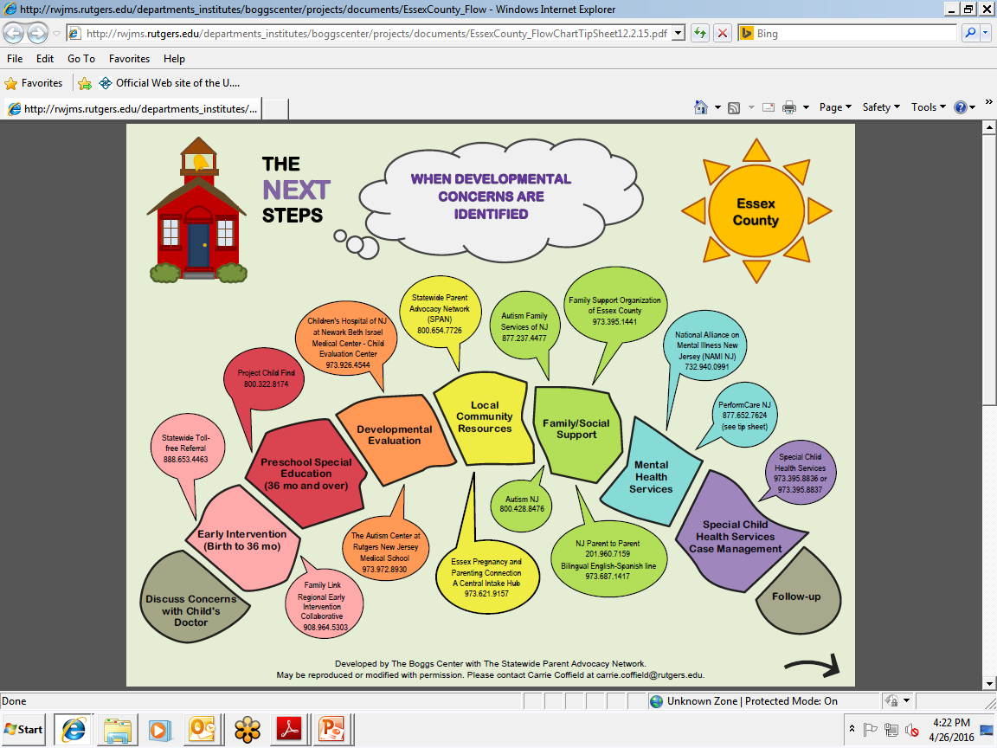
County-specific Flow Charts: Early Child Care Staff
Notes:
Pictured on this slide, is a flow chart that lists several important connections that providers should help families make upon recognizing a developmental concern for their child. A flow chart like this one was developed for each of New Jersey’s 21 counties as part of New Jersey’s second Act Early State System’s Grant project, providing in-person parent led training to Head Start staff. Once again, our goal for these flow charts is for them to serve as a starting point for families, educators, and others to help connect families with the appropriate types of services and supports when a concern about a child’s development is detected. We used the state’s website of evaluation centers to populate the list and listed as many as could fit in the bubbles on the front and on the list on the back, keeping the entire document readable and to one page. We did not intend for this to be an exhaustive list of all the resources available to families. It is our hope that family navigators, supporters or case managers will suggest to families additional connections or resources not included on the charts. These re-designed flow charts are meant to be more colorful and appealing for families and child care staff and are meant to be hung in a central location and/or shared with families.
We are going to revise these soon to include the central intake phone numbers as soon as they are finalized. A statewide version of this flowchart is also being developed and will be available shortly.
In addition, these flow charts will be shared with the central intake care managers and the special child health services case managers.

Slide 22
Concluding Thoughts
Development & dissemination of NJ-specific tools & resources to meet identified needs
Coordination of screening activities across all sectors to maximize impact & reduce duplication
Creation of policies & protocols to address gaps & ensure consistency in access to effective screening.
Focus on diverse family leadership & targeting diverse families & family-serving organizations

Slide 24

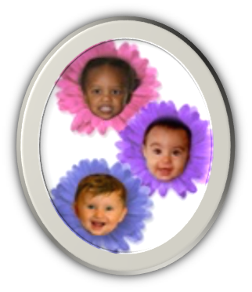
Thank You!
“ACT EARLY”
TO
HELP ME GROW!!
Deepa Srinivasavaradan
CDC’s “Learn the Signs. Act Early.” Ambassador to NJ
Statewide Parent Advocacy Network
deepas@spannj.org

